Slide 1
Scrum-Agile Approach
An alternative for the software development life cycle

Slide 2

Scrum-agile Team
Three essential roles
Product Owner
Scrum Master
Developer(s)
One optional role
Tester(s)

Slide 3
Scrum-agile Team – Product Owner
According to Cobb (2015):
One Product Owner per Scrum team
Similar to a traditional project manager
Bridge between development team and client
Product Owner Responsibilities:
Solely responsible for the Product Backlog
Determine priorities and direction for development
“The Product Owner represents the business sponsor . . .” (p. 35)

Slide 4
Scrum-agile Team – Scrum Master
According to Cobb (2015):
One Scrum Master per Scrum Team
“. . . servant-leader for the scrum team” (p.36)
Expert on Scrum-agile principles and practices
Scrum Master responsibilities:
Coach development team, Product Owner, and stakeholders
Support development team’s success in several ways
Serve the Product Owner

Slide 5
Scrum-agile Team – Developer(s)
According to Cobb (2015):
Cross-functional, self-organizing
No individual titles, no exceptions
Responsibilities:
Develop the project
Turn Product Backlog items into increments
Act as a single entity – no sub-teams
Manage their own work

Slide 6
Scrum-agile Team – Tester(s)
Testers are still part of the development team (Cobb, 2015 p. 38)
According to Ghahrai (2017), responsibilities include:
Define acceptance criteria with Product Owners
“Ensuring proper use of testing tools”
“Understanding, implementing, and updating the Agile Test Strategy”
Coach and collaborate with team members and stakeholders

Slide 7

Software Development Lifecycle (SDLC)
Typical phases (not in order):
Analysis
Plan
Design
Develop
Test
Deploy
Maintenance

Slide 8
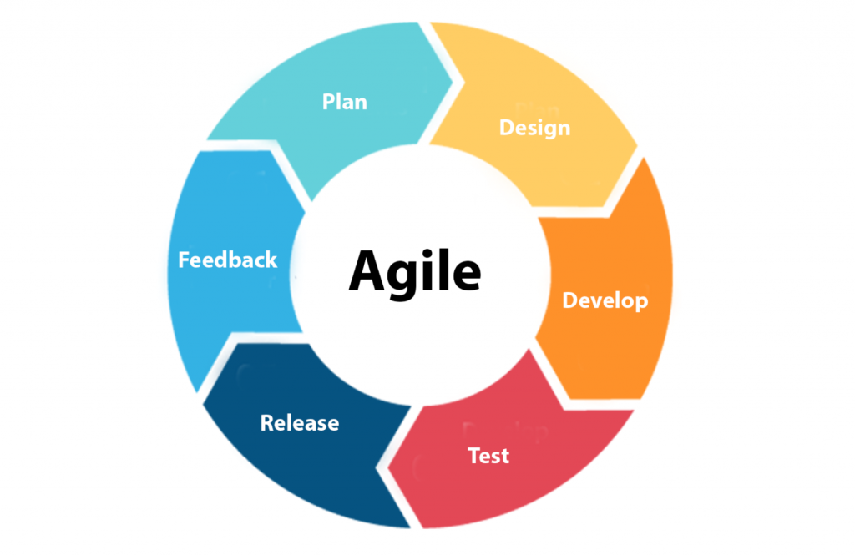
SDLC Phases in Agile
Plan/Analysis – Determine requirements
Design – Determine a framework for the project
Develop – Create the product
Test – Ensure predetermined standards are met
Release – Deploy the product
Feedback – Gather input about the product release
Repeat 1-6 until as necessary
This Photo by Unknown Author is licensed under CC BY

Slide 9
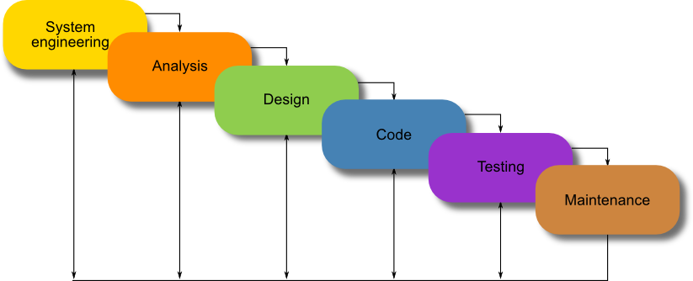
SDLC Phases in Waterfall
In the waterfall approach, there is no feedback loop. The product is given to the client when it is done.
This Photo by Unknown Author is licensed under CC BY
Determine the project’s requirements
Establish framework for the product
Create the actual product
Ensure product meets requirements
Fix additional issues as discovered

Slide 10
Project Execution: Agile vs. Waterfall
Agile
Waterfall
SNHU Travel switching their product focus caused minimal disruption to the project.
Development team members could go on vacation or FMLA leave without majorly disrupting the project’s progress.
SNHU Travel would not have been able to request the product shift without resetting the project.
Ill-timed extended absences of a team member could disrupt the entire project depending on their role.

Slide 11
Choosing Between Agile & Waterfall
Factors to Consider
Choose Agile
Choose Waterfall
Are the requirements subject to change?
Does the project require extensive documentation?
Is the team expected to change within the time frame of the project?
Yes, requirements may change
No, documentation is not a high priority
No, the team is expected to be stable throughout the project
No, requirements are absolute
Yes, documentation is of utmost importance
Yes, the team may be changing over the duration of the project

Slide 12

Conclusion
Software moves fast.
Agile lets development teams move faster.
“We do quality, quickly”

Slide 13
Works cited:
Charles G. Cobb. (2015). The Project Manager’s Guide to Mastering Agile : Principles and Practices for an Adaptive Approach. Wiley.
Ghahrai, A. (2017, January 6). Agile Testing Mindset and the Role of the Agile Tester. DevQA. Retrieved February 20, 2022, from https://devqa.io/agile-testing-mindset-tester-role-agile-team/

